Slide 1



A New Cylindrical Detector System for Next Kaonic Nuclei exp. at J-PARC
Yuto Kimura, for the J-PARC E80 collaboration RARiS, Tohoku University RIKEN Nishina Center for Accelerator-Based Science, RIKEN
E-Mail: y_kimura@raris.tohoku.ac.jp

Slide 2
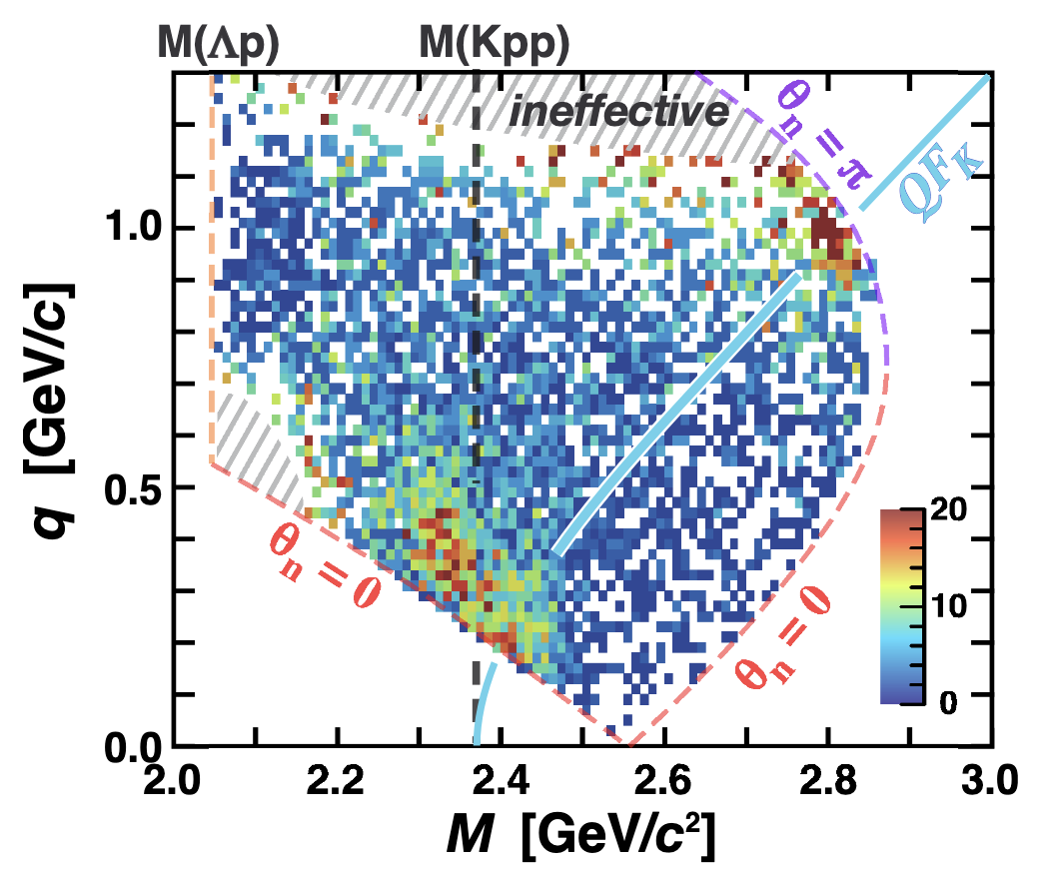
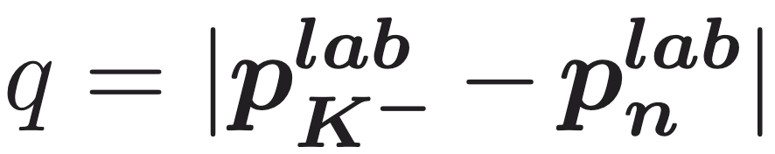
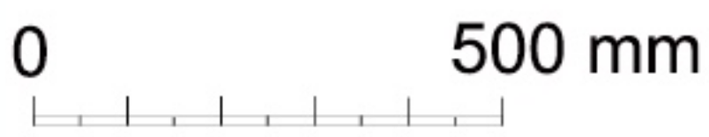
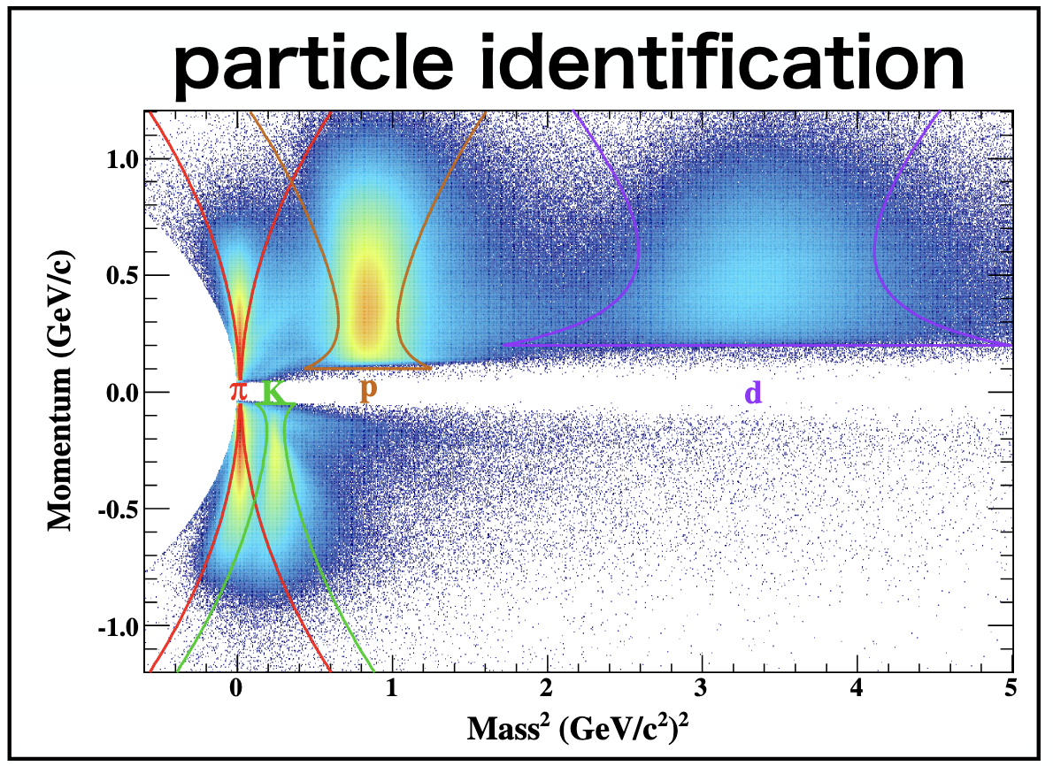
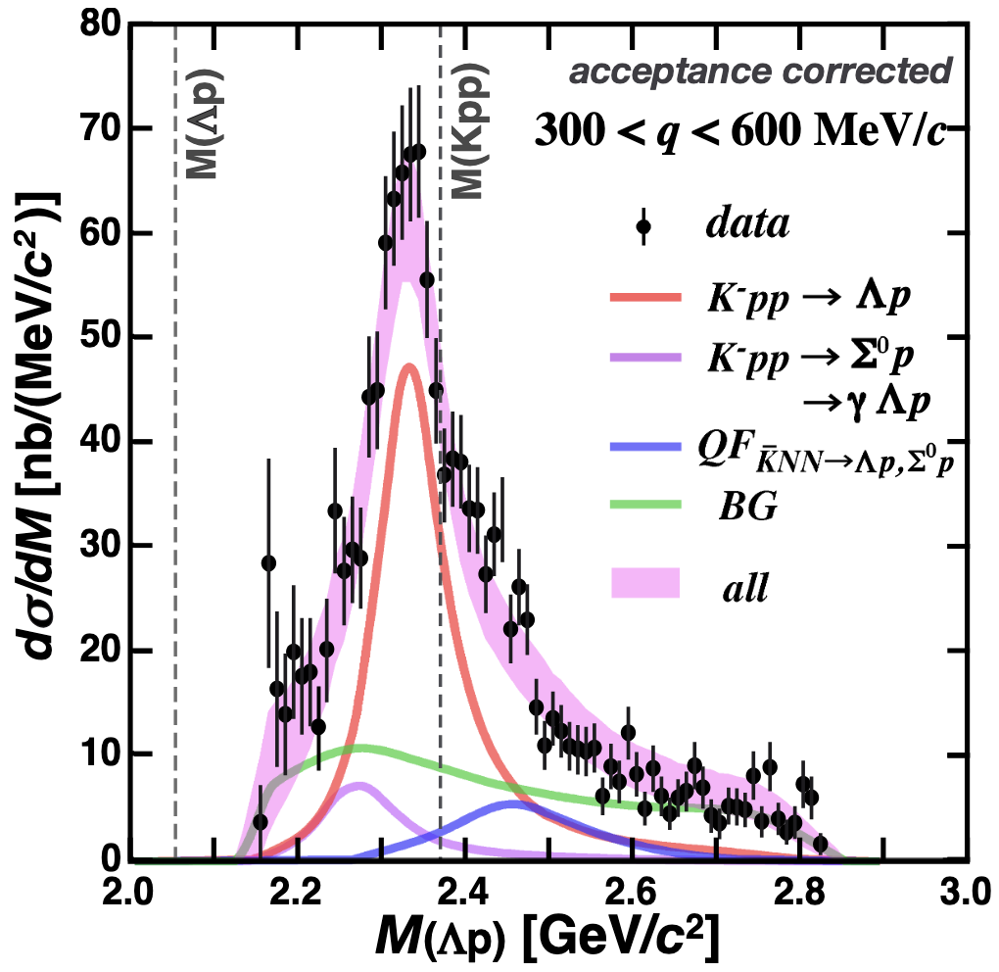

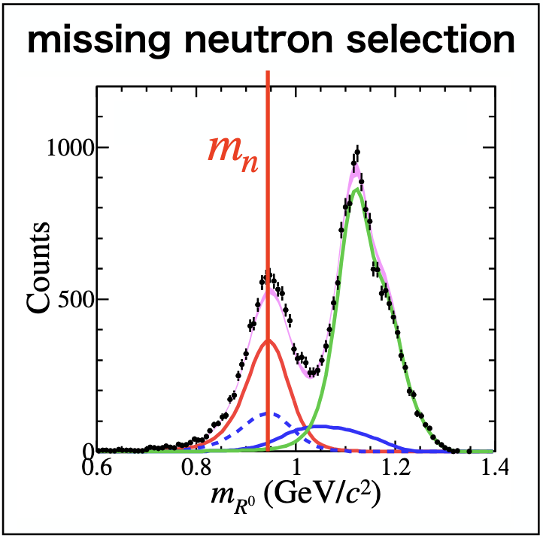


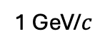



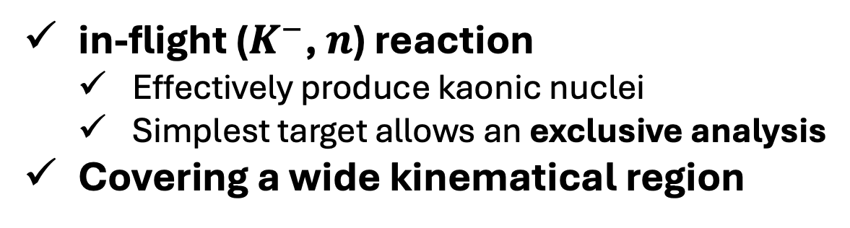


“$K^{−}pp$” observed : J-PARC E15
2
in-flight ($K^{−}$, $n$) reaction
Effectively produce kaonic nuclei
Simplest target allows an exclusive analysis
Covering a wide kinematical region
Bound
Unbound
$$π^{−}$$
$$p$$
projection
1 GeV/$c$
$$Λ$$
$$n$$
$$K^{−}$$
missing
$$K^{−}pp$$
³He-target
CDC (Tracker)
CDH (TOF counter)
$$p$$
Solenoid

Slide 3
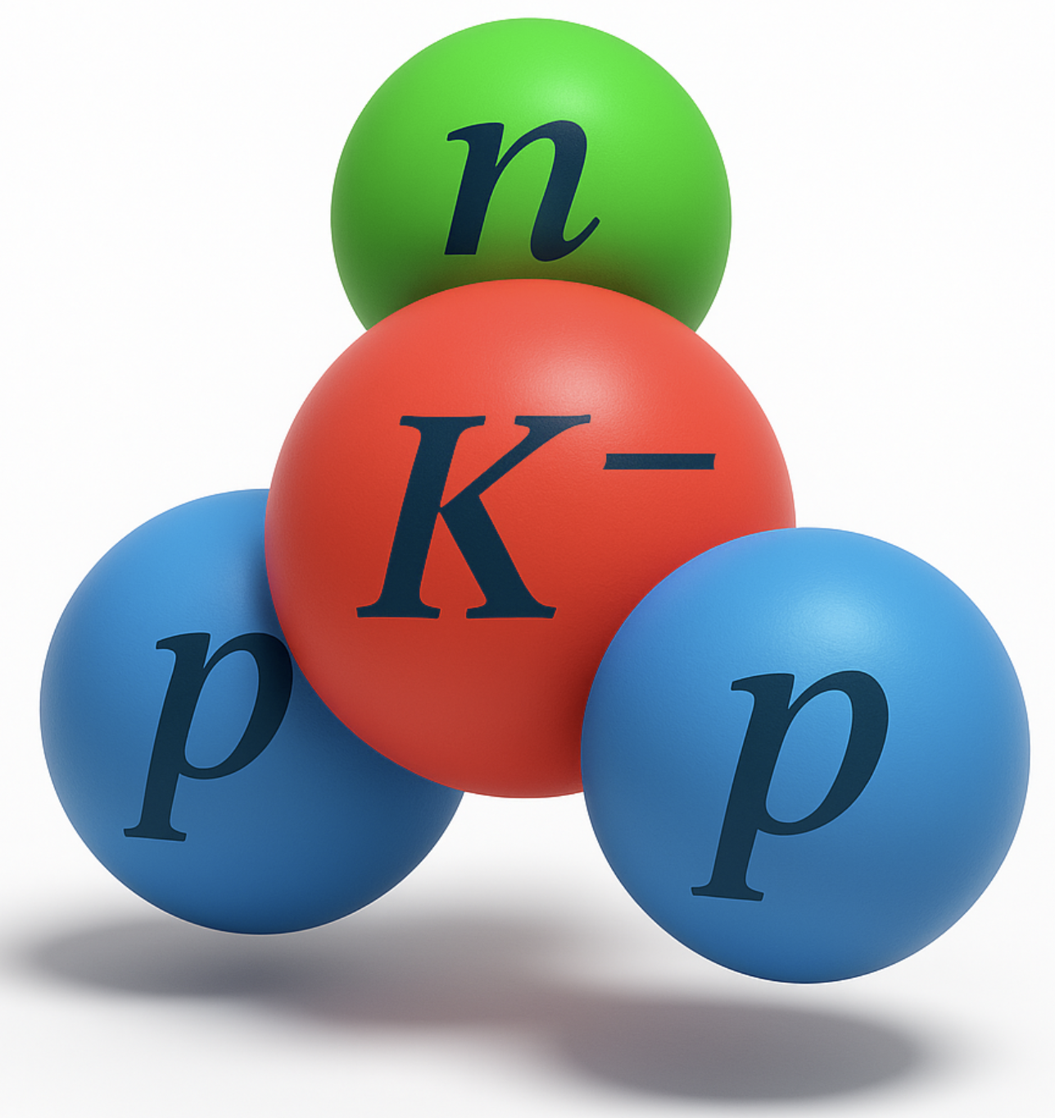
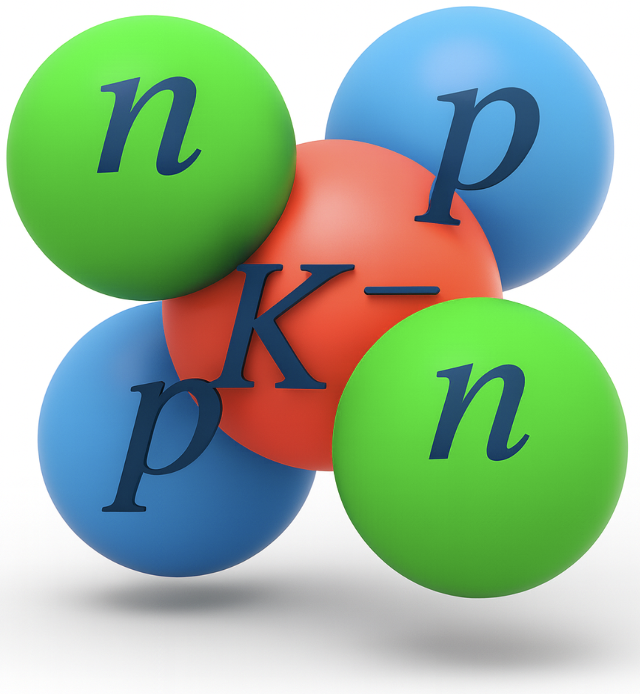
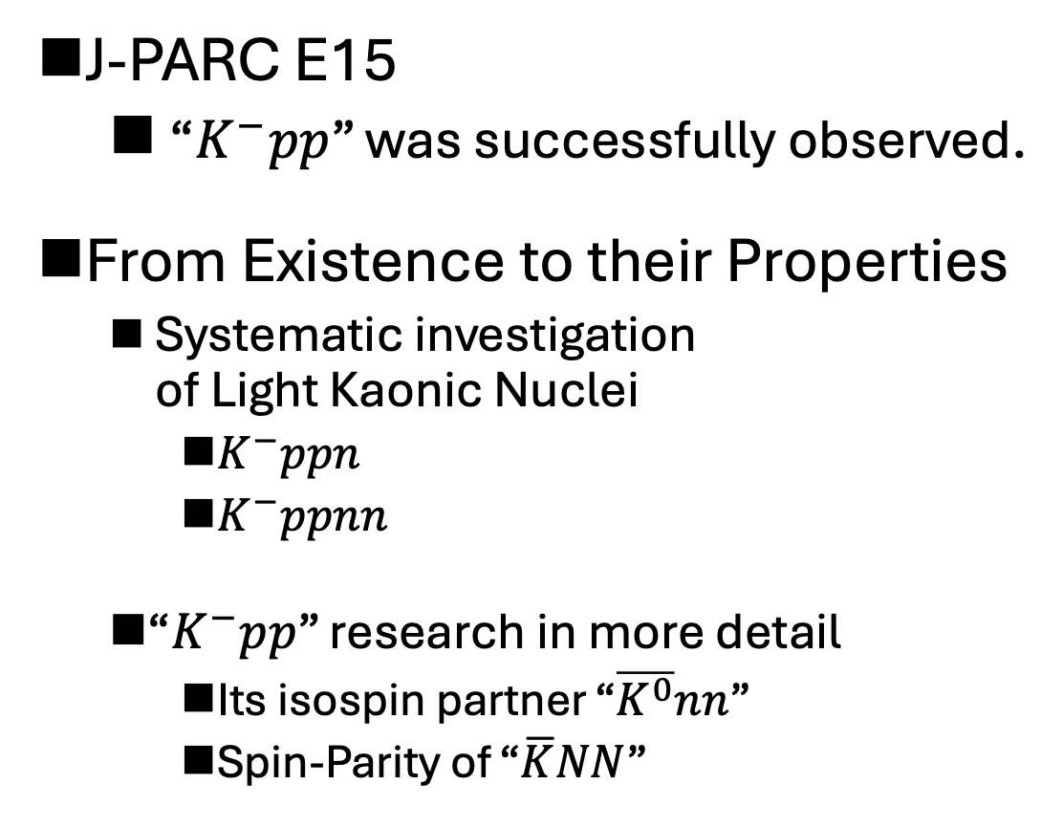
Next Kaonic Nuclei Experiments
3
J-PARC E15
“$K^{−}pp$” was successfully observed.
From Existence to their Properties
Systematic investigation of Light Kaonic Nuclei
$K^{−}ppn$
$K^{−}ppnn$
“$K^{−}pp$” research in more detail
Its isospin partner “$\overline{K^{0}}nn$”
Spin-Parity of “$\overline{K}NN$”
J-PARC E80 in 2027: First step toward these future exp.
Notes:
ここにフォーカスして 検出器の説明をする。

Slide 4

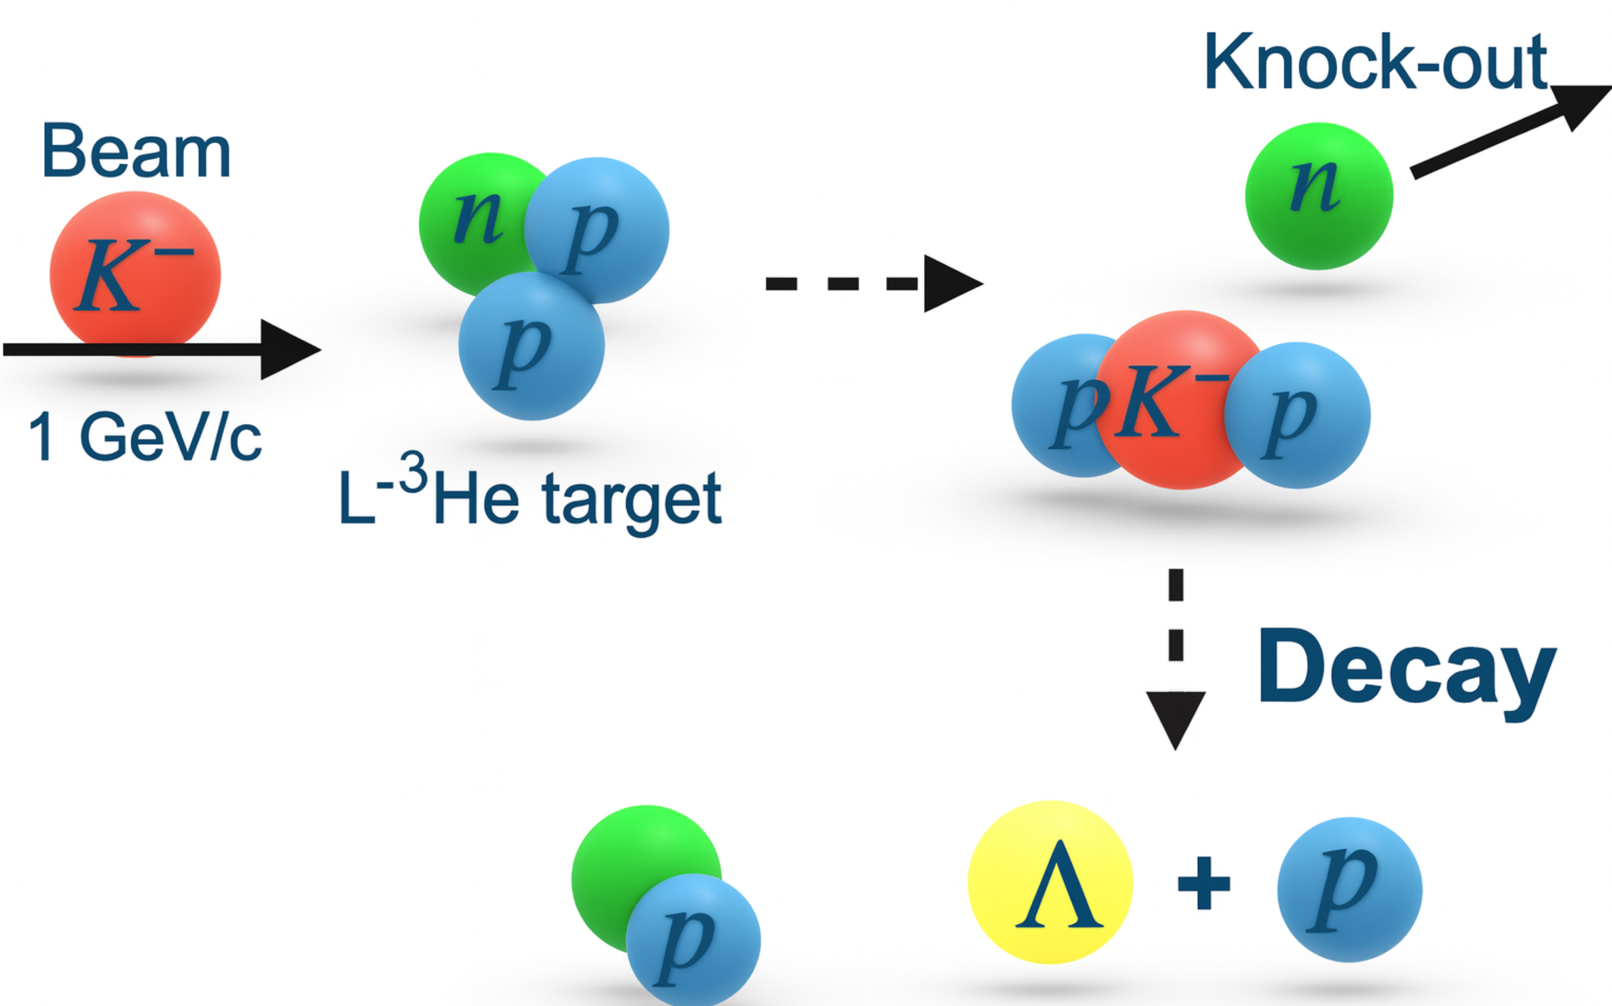
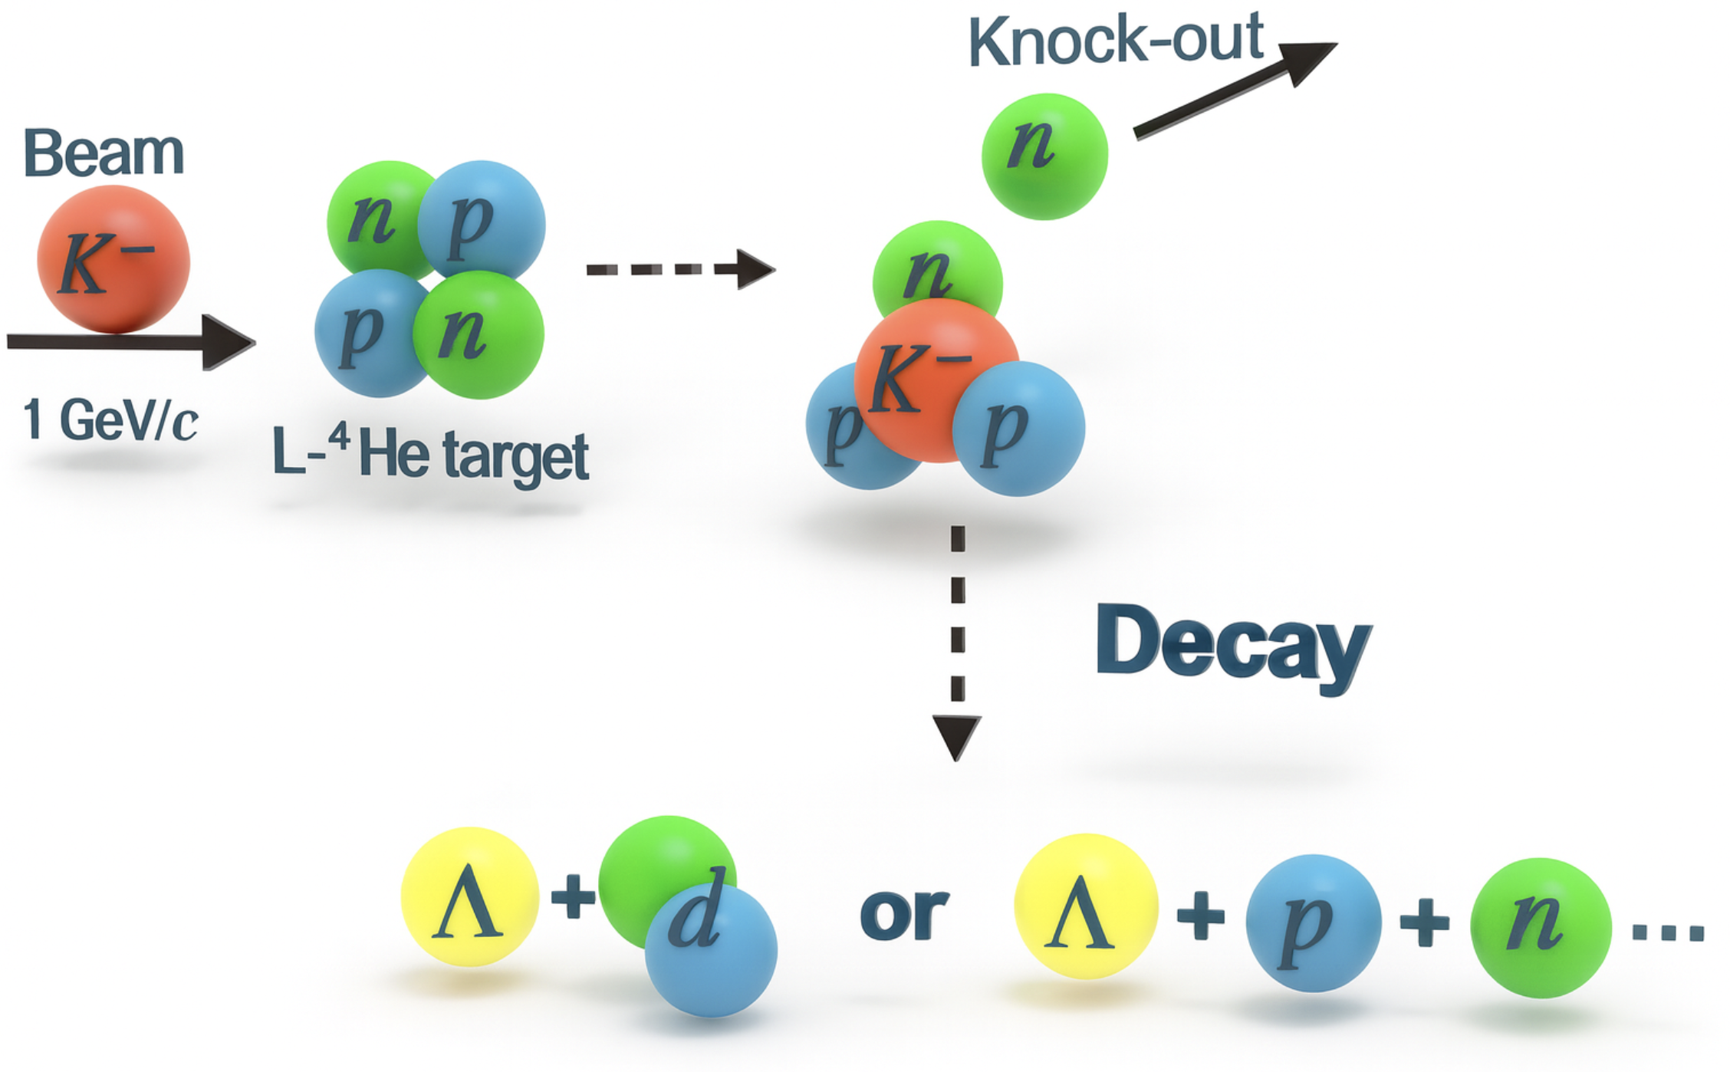
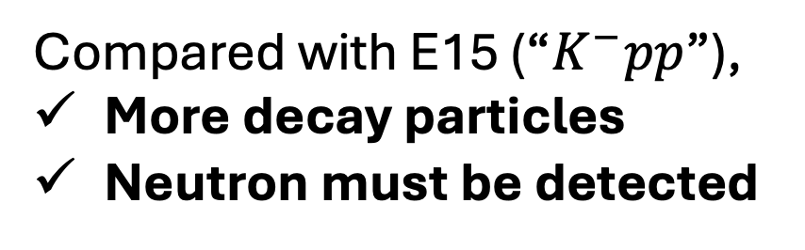
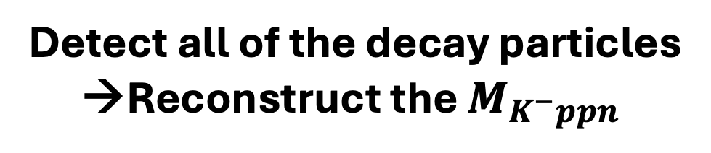
“$K^{−}ppn$” Search: J-PARC E80
4
The experimental method follows that of J-PARC E15.
c.f.) Reaction in E15
Reaction in E80
Compared with E15 (“$K^{−}pp$”),
More decay particles
Neutron must be detected
Our detector system must have
Larger solid angle
Better neutron detection efficiency
Detect all of the decay particles →Reconstruct the $M_{K^{−}ppn}$
Notes:
より詳細な物理は橋本さんが喋るので僕は検出器

Slide 5
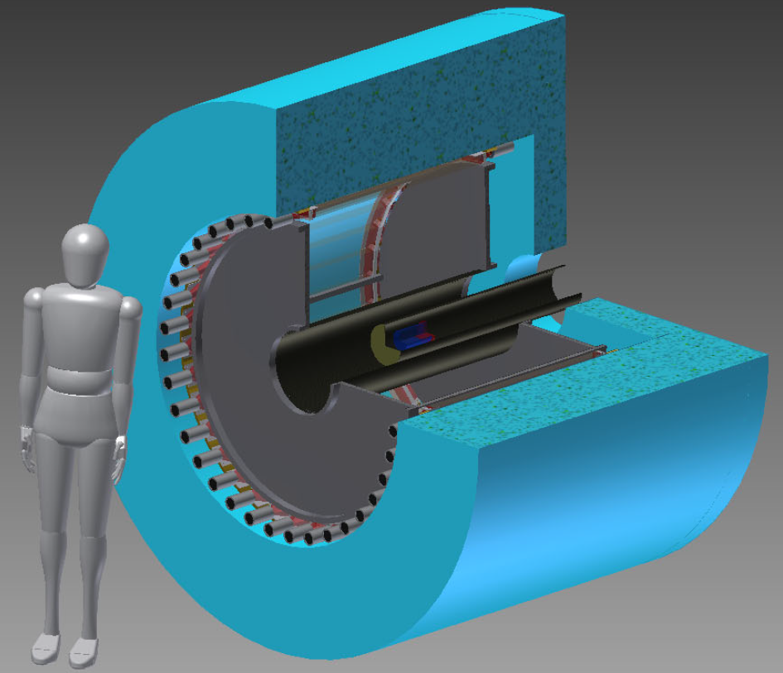
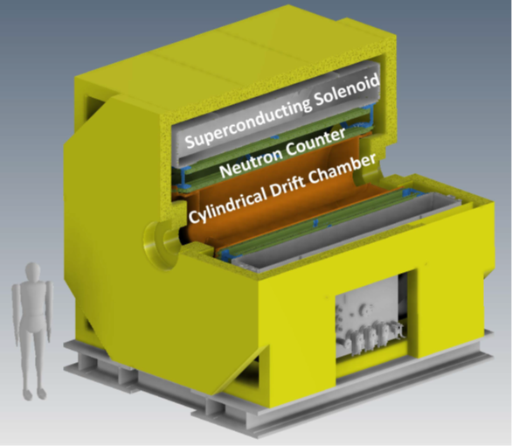
New Cylindrical Detector System, CDS
5
E15-CDS
New CDS
~8 times the volume
1.48 m
1.97 m
To extend the detectors along beam ax., and to increase the total thickness of the neutron counter,
Beam
Superconducting Solenoid Magnet
(The same design as the COMET DS)
Inner bore: 180cm (E15: 59cm)
Length (beam ax.): 320cm (E15: 117cm)
Max. field of 1.0T @ center
3.28 m
3.85 m
Notes:
なんとなくこれくらい大きくなります。
2*2*2で8倍。
CNC入れたい、CNCとCDCを長くしたいから Solenoid(スペックもさらっとここで)のinner大きくした。ボア(X m)とここに書く。
Comet DSと同じデザイン

Slide 6
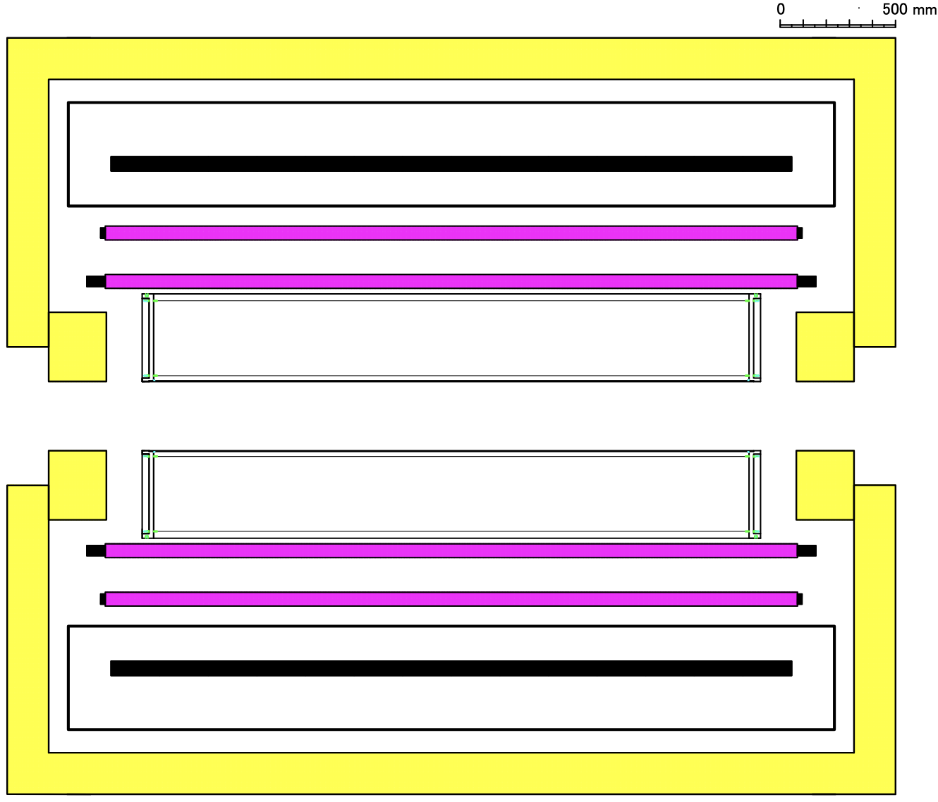
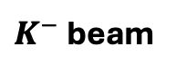
How to upgrade
6
Yoke
Cylindrical Neutron Counter, CNC
Plastic Scintillator, 138 segments
300cm×6cm×6cm
2 Layers on a cylindrical geometry
Total thickness 12cm (E15-CDH: 3cm)
Solenoid
CNC
268cm
CDC
$K^{−}$ beam
95cm
E15-CDC
Cylindrical Drift Chamber, CDC
The same cell-structure design as the E15-CDC (8,244 wires)
Length 268 cm (E15-CDC: 95cm)
Compared to E15’s detectors,
CNC and CDC are extended about x3 longer along the beam axis.
→ Solid Angle: x1.6 (59% → 93%)
CNC thickness is increased x4.
→ Neutron Eff.: x7 (3% → 12%x1.6=21%)
Notes:
どういう思想？ NCを入れるために Solenoidをデカ隠した。 分解能は同じですを強調

Slide 7
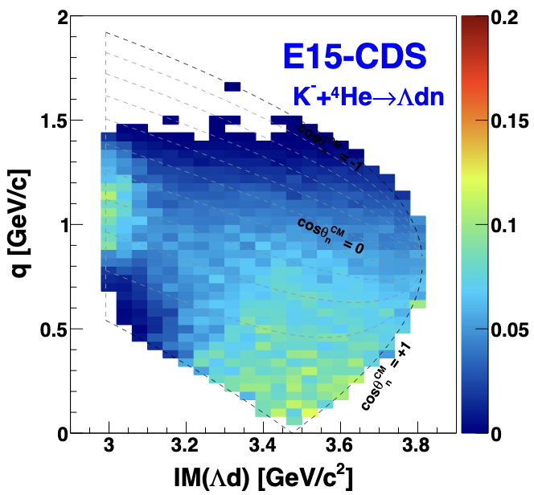
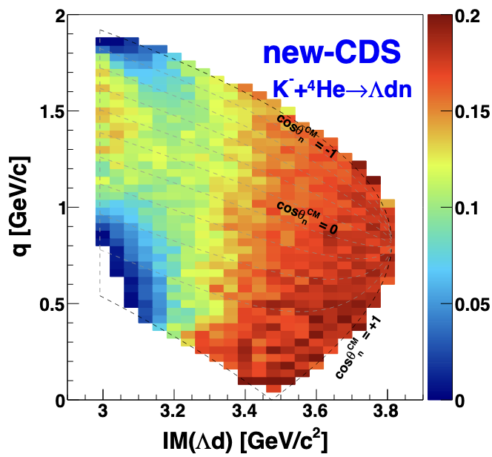
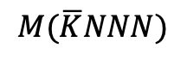
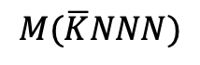
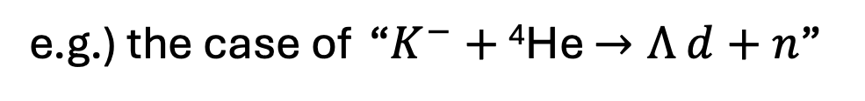
Acceptance improvement
7
e.g.) the case of “$K^{−}+$ ⁴He $→Λ d+n$”
$$M(\overline{K}NNN)$$
$$M(\overline{K}NNN)$$
Bound
Bound
upgrade
Enable analysis over a much wider kinematical region
Data taking will become ~3 times more efficient.
Notes:
こういうことをしたいから乞おういう検出器を作った・
３隊崩壊をメインにした方がいい。
なんのありがたみがあるのか・

Slide 8
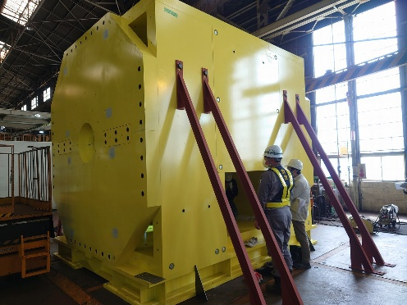
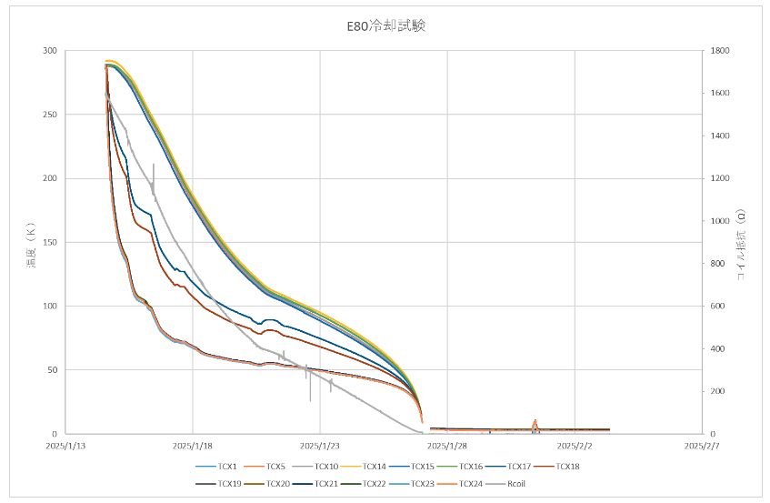
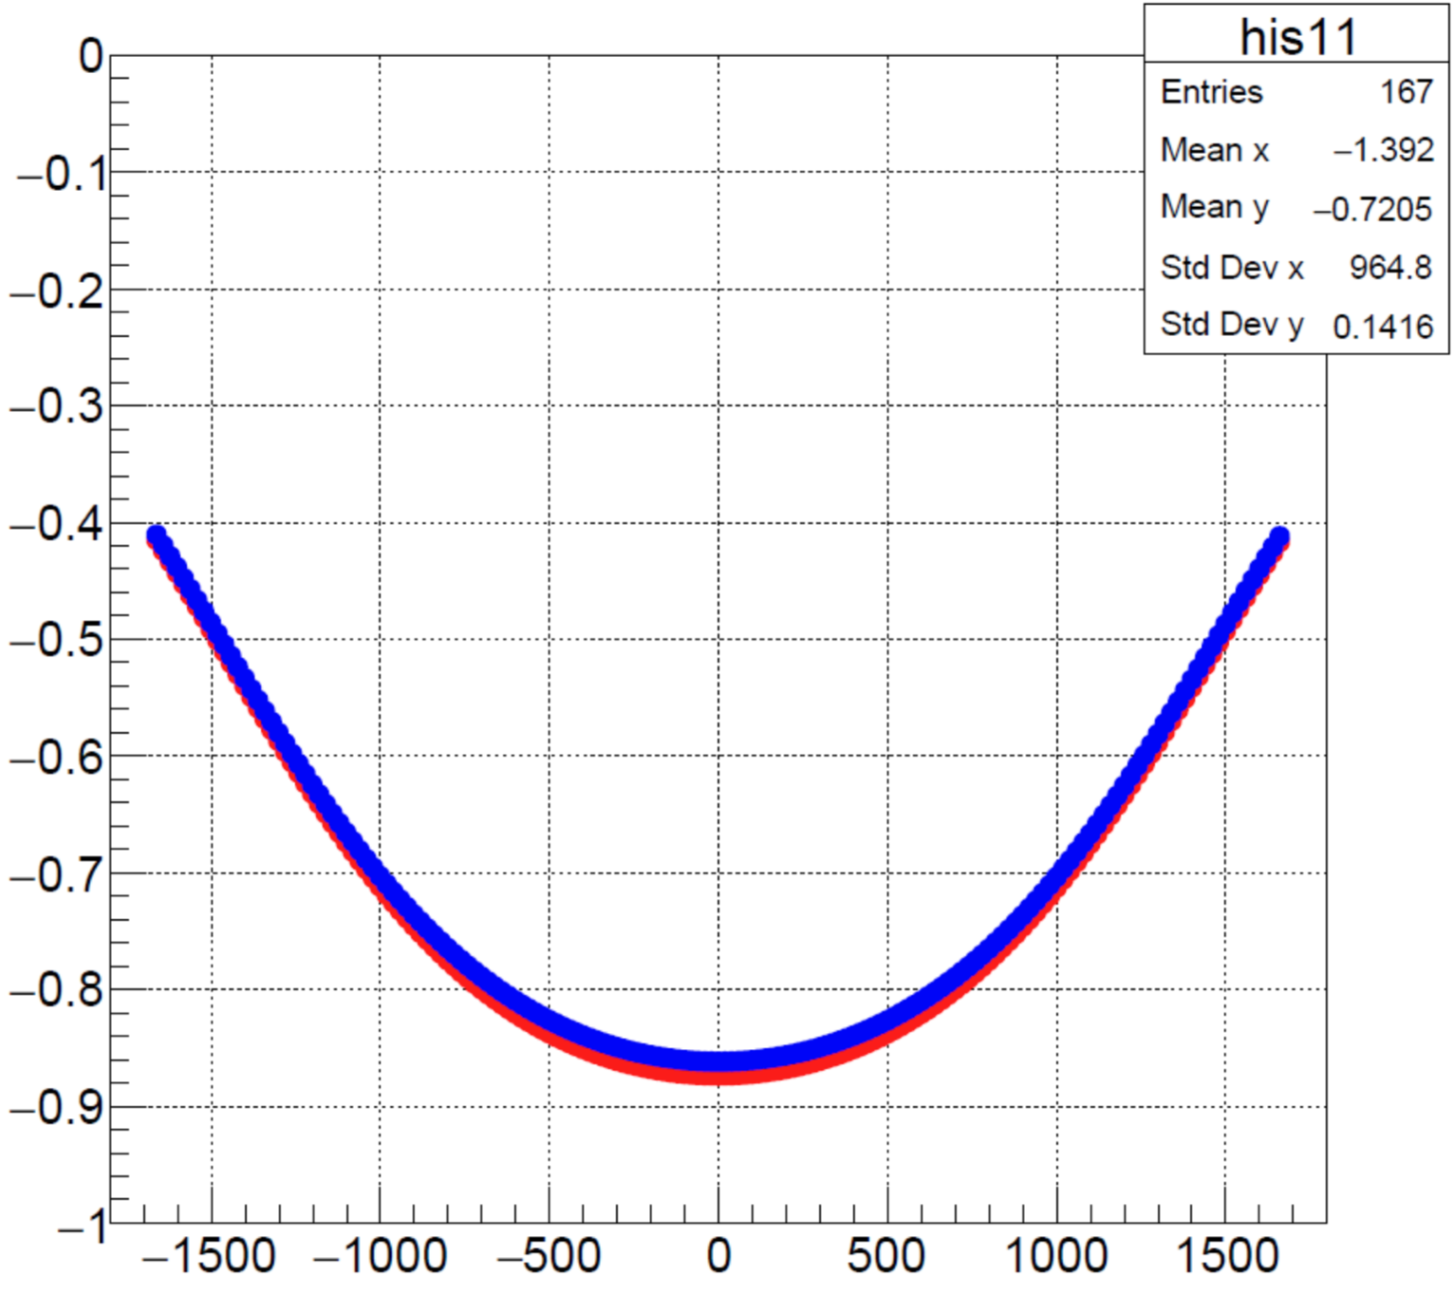
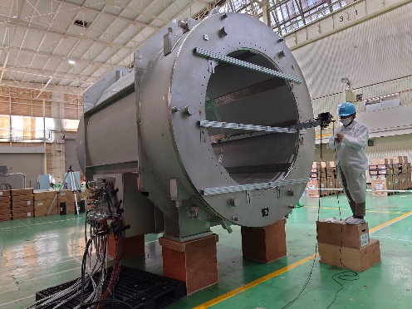
Status: SC Solenoid
8
Return Yoke
Magnetic field measurement w/o yoke @TOSHIBA (Beam axis scan, I = 189A)
Cooling Test
300
Simulation
Measured
250
200
Temperature [K]
150
100
50
SC Solenoid
0
2025/1/13
2025/1/23
2025/2/2
With GM refrigerators, we achieved stable cooling down to the nominal temperature of 4K.
Measured magnetic field w/o Yoke was consistent with TOSCA calculation.

Slide 9
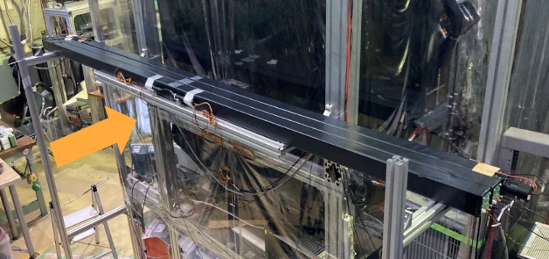
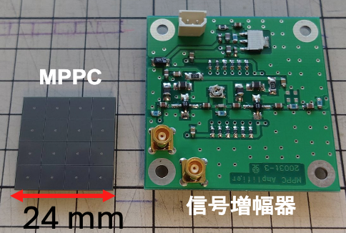
Status: CNC
9
Proto-type test exp. in 2025
Result
(Required time reso. ~80 ps)
Counter | Read out | Length | thickness | Time Reso.
E15-CDH | PMT | 80 cm | 3 cm | ~ 80 ps
CNC | PMT | 300 cm | 6 cm | ~ 120 ps
CNC | MPPC | 300 cm | 6 cm | ~ 80 ps
300cm
Beam
Readout of E15-CDH is not applicable for 3m long plastic scintillators.
To improve light collection efficiency, we decided to use MPPCs w/o light guides.
MPPC (Hamamatsu)
S13361-6050AE-04
6 mm square, 4×4 array
Signal Amplifier
Two-stage RF amplifier
PZC circuit
MPPC
We achieved required value σ ~80 ps even with 3m length scintillators.
Now all 138 modules are in hand.
Signal Amplifier
Notes:
角度依存と位置依存は大丈夫？（想定質問） 単にE15-CDHのままだとダメ。 就航効率を考えてライトガイドなしでMPPCに。それでようやく８０ps
表も作ってみてください(CDHとの比較。)

Slide 10
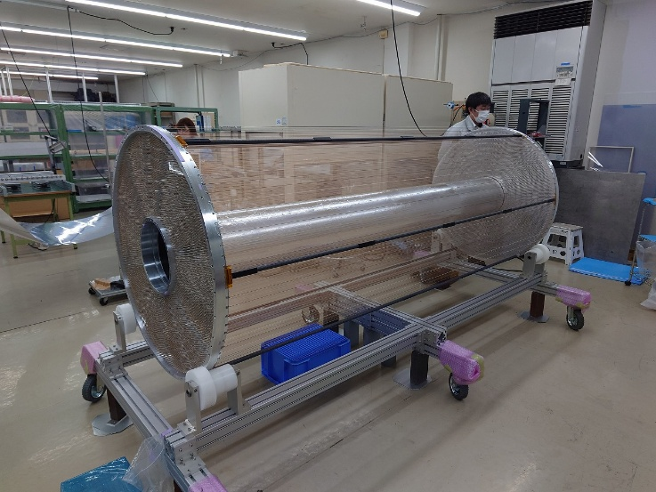
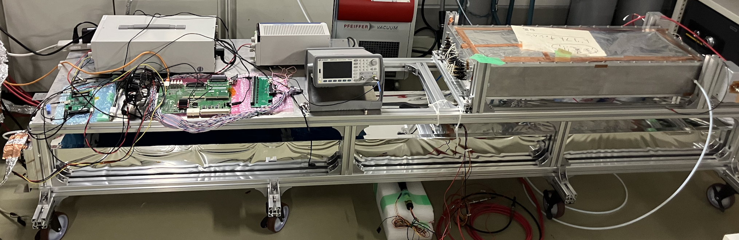
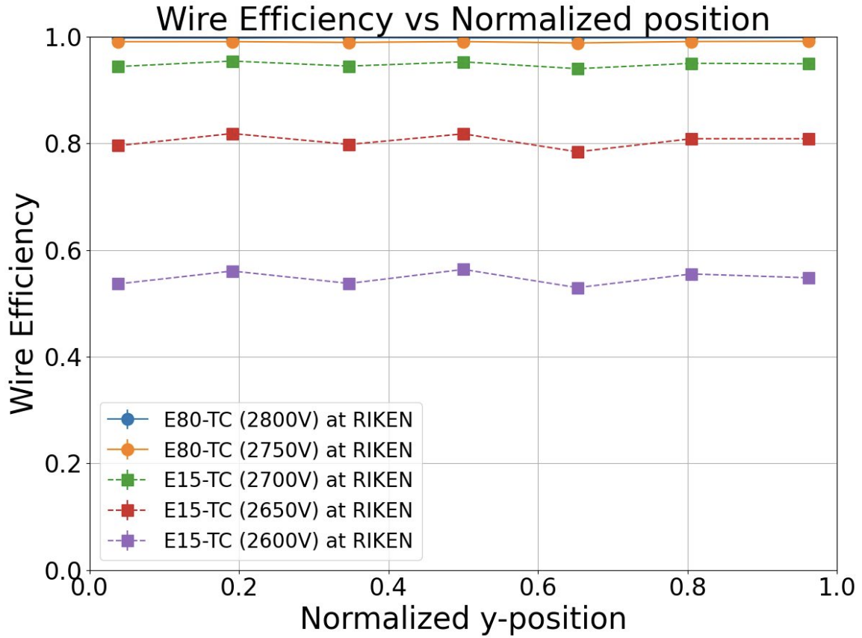
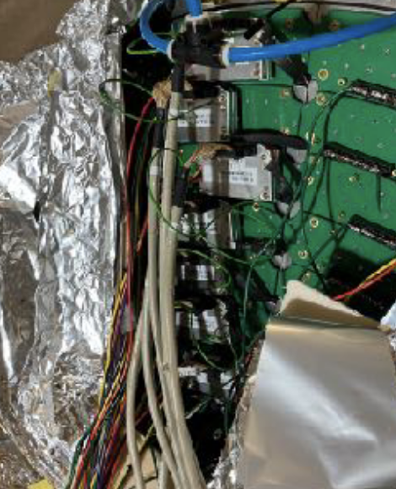
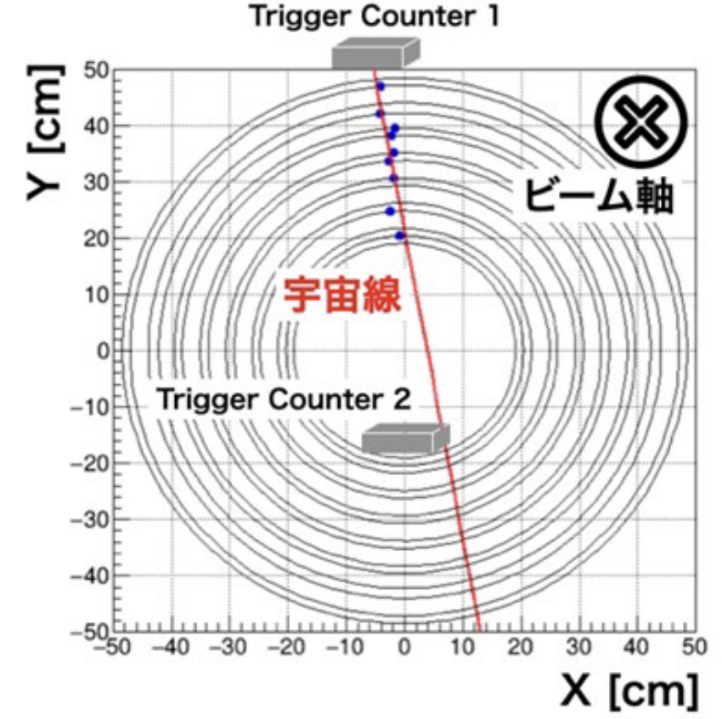
Status: CDC
10
CDC
Test chamber
268cm
268cm
Wire Efficiency vs Position
φ106cm
CDC w/ partial Pre-amp
2800V (wire length: 262cm)
2750V (wire length: 262cm)
2700V (wire length: 262cm)
2650V (wire length: 262cm)
2600V (wire length: 262cm)
Beam axis
Cosmic Ray
~100% efficiency even w/ 268cm wire, no position dependence
w/ partial preamps, cosmic-ray track was successfully reconstructed by CDC.
We will start commissioning with full readout.

Slide 11
Summary
11
We developed and constructed a large‐acceptance Cylindrical Detector System (CDS) for the future kaonic nuclei experiments.
The three main components (SC Solenoid, CNC and CDC) have been established.
Installation of the new CDS to K1.8BR is scheduled for 2026, and we plan to start the physics run (J-PARC E80) in 2027.
For details on the physics of kaonic nuclei experiment, please refer to Dr. T. Hashimoto’s talk on Thursday, and for related detectors, to the poster presentation by Yuto Tsutsumi (No. 68).

Slide 12

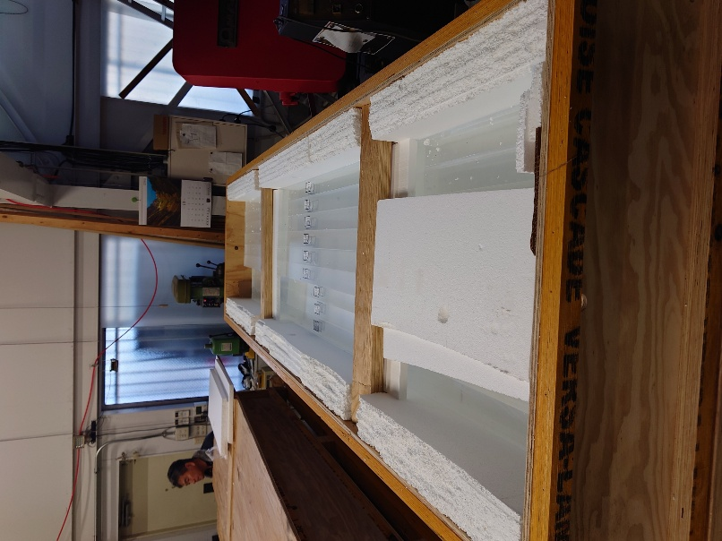

Thank you for listening.

Slide 13
Back Up

Slide 14
New Cylindrical Detector System, CDS
14
For our next kaonic nuclei experiments,
“High-precision”
“Efficient Neutron Detection”
“Large Acceptance”
are important.
Keep the performance of the old CDS
Upgrade with the new CDS
New CDS
Present CDS
1.48 m
Beam
3.85 m
1.97 m
3.28 m
Notes:
どういう思想？ NCを入れるために Solenoidをデカ隠した。 分解能は同じですを強調

Slide 15


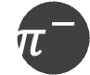
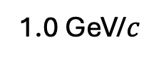




Event Reconstruction
15
York
Charged Particle
CDC x Solenoid
Momentum analysis
Reaction Vertex
CNC
PID by TOF
Neutron
CNC
Momentum
Solenoid
$$π^{−}$$
$$p$$
CNC
CDC
$$Λ$$
$$n$$
$$K^{−}$$
missing
1.0 GeV/$c$
L-⁴He target
$$p$$
$$n$$
Notes:
どういう思想？ NCを入れるために Solenoidをデカ隠した。 分解能は同じですを強調

Slide 16
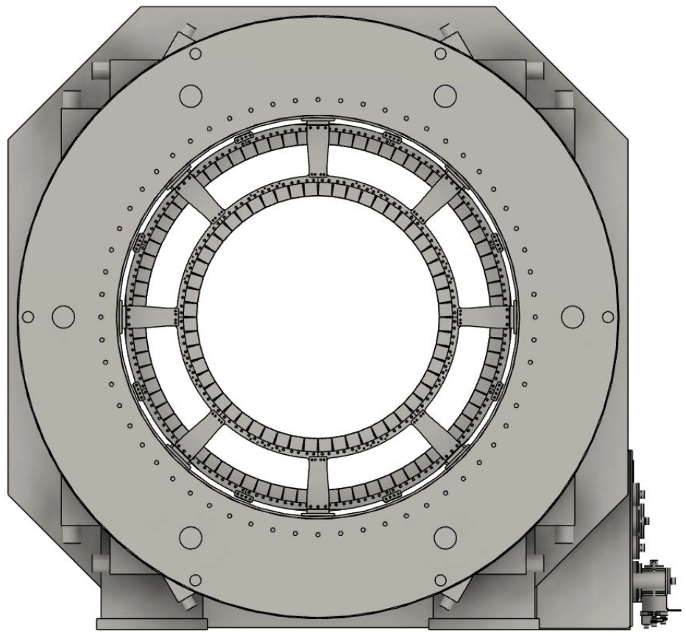
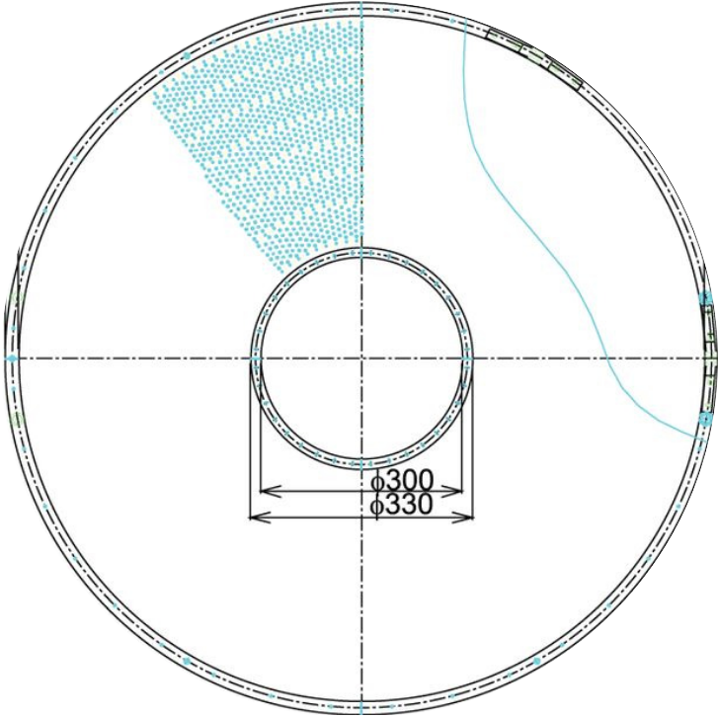
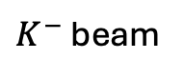
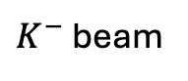
How to upgrade
16
Solid Angle: x1.6 (59% → 93%)
Extend CNC and CDC about x3 longer along the beam axis
Neutron Eff.: x7 (3% → 12%x1.6)
Enlarged solenoid, then CNC thickness x4
York
Solenoid
Solenoid
CNC
CNC
CDC
$K^{−}$ beam
$K^{−}$ beam
E15-CDC
CDC
E15-Solenoid inner
E15-Solenoid outer
E15-Solenoid inner
E15-Solenoid outer
* The radius of the new CDC is equal to E15-CDC.
Notes:
どういう思想？ NCを入れるために Solenoidをデカ隠した。 分解能は同じですを強調

Slide 17
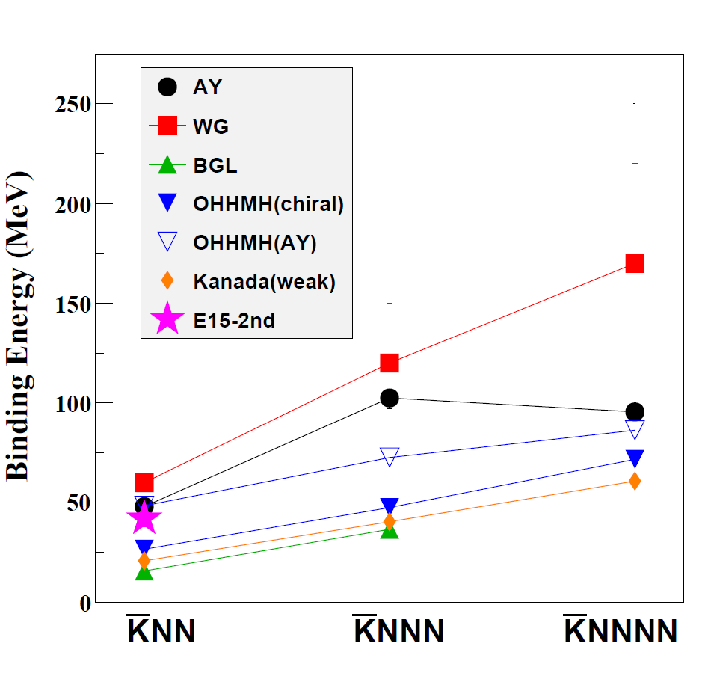
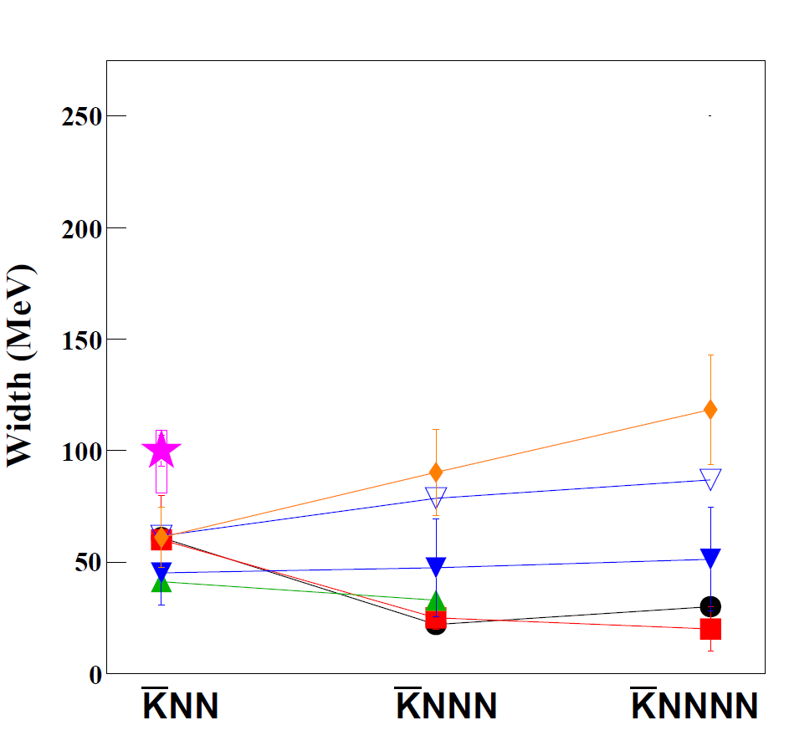
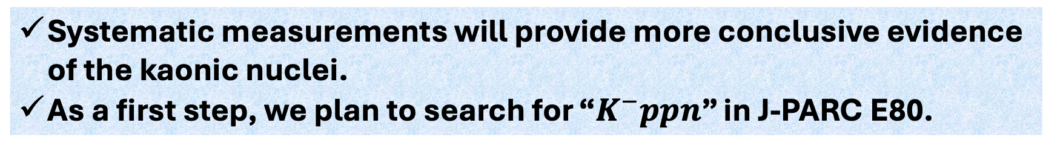
Mass Number Dependence
17
Theoretical calculation vs Measured B.E and Γ
There is uncertainty between the different theories.
AY: PRC65(2002)044005, PLB535(2002)70.
WG: PRC79(2009)014001.
BGL: PLB712(2012)132.
OHHMH: PRC95(2017)065202.
Kanada: EPJA57(2021)185.
B.E.
the larger nuclei → the larger B.E.
Γ
→similar width
(mesonic only)
= without multi-N absorption
Systematic measurements will provide more conclusive evidence of the kaonic nuclei.
As a first step, we plan to search for “$K^{−}ppn$” in J-PARC E80.

Slide 18
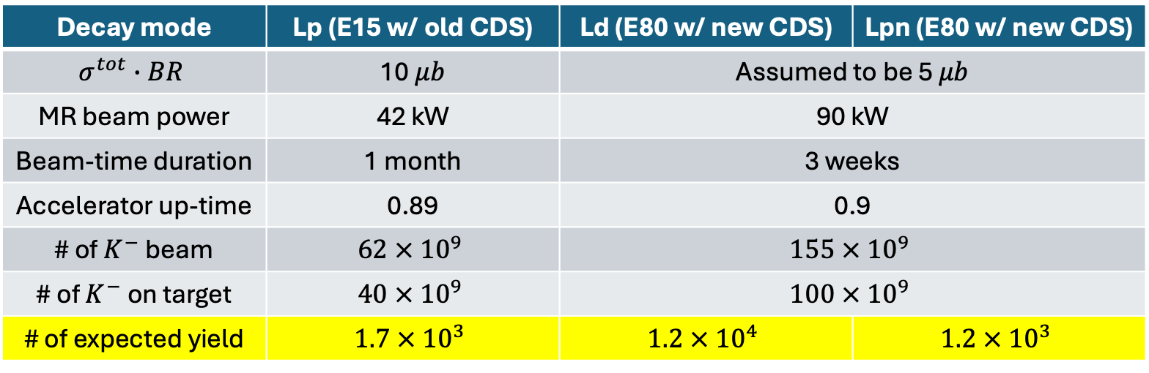
Acceptance and yield
18
More efficient data taking
Enable us analyze on larger kinematical region
Upgrade
Λd ~ 10 times statistic than K-pp
Λpn ~ the same order as K-pp
Decay mode | Lp (E15 w/ old CDS) | Ld (E80 w/ new CDS) | Lpn (E80 w/ new CDS)
$$σ^{tot}∙BR$$ | 10 $μb$ | Assumed to be 5 $μb$
MR beam power | 42 kW | 90 kW
Beam-time duration | 1 month | 3 weeks
Accelerator up-time | 0.89 | 0.9
# of $K^{−}$ beam | $$62 × {10}^{9}$$ | $$155 × {10}^{9}$$
# of $K^{−}$ on target | $$40 × {10}^{9}$$ | $$100 × {10}^{9}$$
# of expected yield | $$1.7 × {10}^{3}$$ | $$1.2 × {10}^{4}$$ | $$1.2 × {10}^{3}$$
Notes:
どういう思想？ NCを入れるために Solenoidをデカ隠した。 分解能は同じですを強調

Slide 19
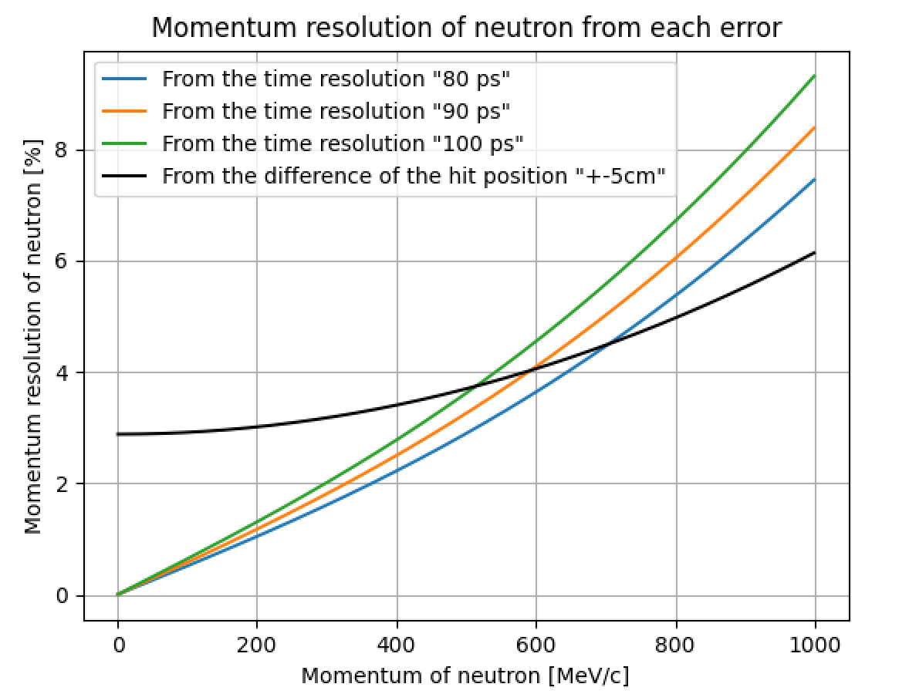
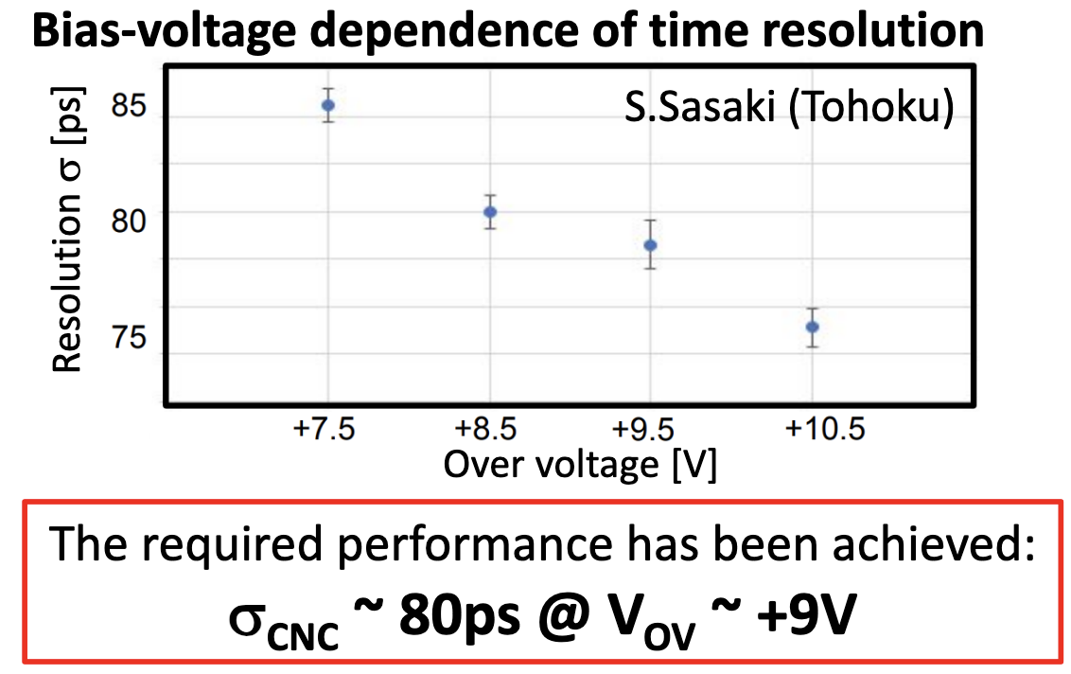
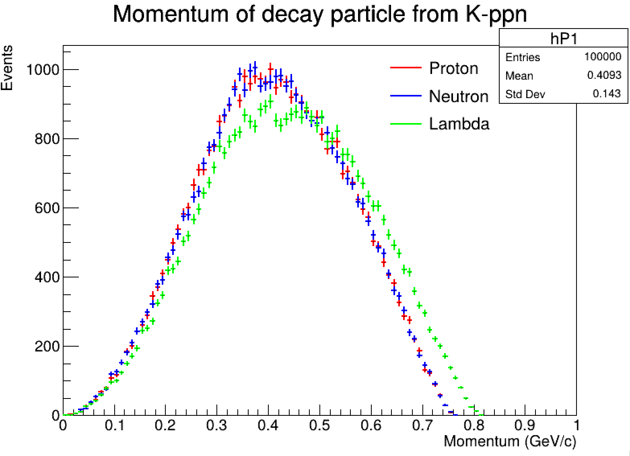
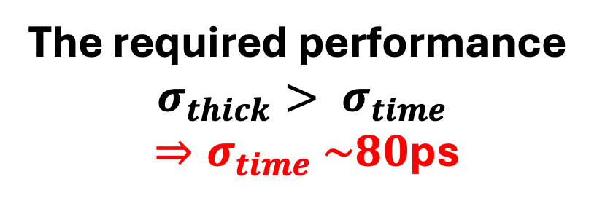
Cylindrical Neutron Counter, CNC
19
The required performance
$$σ_{thick}> σ_{time}$$
$⇒σ_{time} \sim 80$ps
Proto-type test exp. in 2025

Slide 20
CNC
20
Proto-type test exp. in 2025
Read-out study w/ prototype has done! (achieved required value σ ~80 ps even if 3m length counter)
138 modules is in hand.
Notes:
角度依存と位置依存は大丈夫？（想定質問）

Slide 21

Construction status
21
Return York
SC Solenoid
Install into K1.8BR beamline in 2026
Final measurement of the magnetic field w/ the york
CNC
CDC
Completed!
in commissioning!

Slide 22


Slide 23


Slide 24


Time resolution of CNC
24

Slide 25

Momentum Resolution of CDC
25

Slide 26

Why K-ppn → Λ p n ?
26

Slide 27

Acceptance improvement
27

Slide 28
Others
28
The Λpn decay channel allows us to detect all final-state particles easily.
By going from K^-pp to K^-ppn and K^-ppnn, we can study how the binding energy and decay width evolve with the number of nucleons.
Such studies are directly connected to the physics of dense nuclear matter, which is relevant for neutron stars.
Any new particle or exotic nucleus is first confirmed in dedicated experiments.
Only after accumulating sufficient evidence across multiple experiments does it get listed in the PDG.
“Aren’t there other possibilities besides K^-pp? For example, Sigma?”
We checked alternative scenarios, but the kinematics are best explained by K^-pp.
That is a very important point, and actually, Dr. Hashimoto will give a dedicated talk on Thursday focusing on the physics aspects. I recommend attending his talk for a more detailed discussion.
“How can you say the K^- is real?”
That is a very important point, and actually, Dr. Hashimoto will give a dedicated talk on Thursday focusing on the physics aspects. I recommend attending his talk for a more detailed discussion.
“Can you extend this to heavy nuclei like iron or lead?”
In principle, yes, kaonic bound systems in heavier nuclei are of great interest.
However, our current focus is on light kaonic nuclei, where we can perform fully exclusive measurements.
We have already confirmed that there is no position dependence. As for the angle dependence, to be honest, we have not yet tested it experimentally. It may require some adjustment of the readout side — namely, the MPPC preamps and the dynamic range of the QDC.

Slide 29








Others
29
To reconstruct the reaction mechanism comprehensively, we need data from as wide a phase space as possible.
Wide acceptance is necessary to find such “sweet spots.”
That is a very important point, and actually, Dr. Hashimoto will give a dedicated talk on Thursday focusing on the physics aspects. I recommend attending his talk for a more detailed discussion.
$$π^{−}$$
$$p$$
1 GeV/$c$
$$Λ$$
$$n$$
$$K^{−}$$
$$K^{−}pp$$
³He標的
飛跡検出器
シンチレーション 検出器
$$p$$
ソレノイド

